Slide 1
How to Use This Template
Follow the instructions in Lab: Modernizing Digital Banking Operations at a Retail Bank to create this presentation.
Ensure all content is visible on the slides, since you’ll be saving this presentation in the PDF format. Don’t include any content in the note section.
Do not insert screenshots of the completed templates. Instead, copy and paste the tables directly from the Word/Excel templates into the slides.
Avoid animations, as they may not display consistently.
Add as many slides as needed to effectively present your content.
Expand the template tables with additional rows as necessary.
Feel free to include images or other elements to enhance your presentation.
Note: Before submission, remove the instruction and table of contents slides and any placeholder instructions highlighted in yellow on individual slides.

Slide 2
Modernizing Digital Banking Operations at a Retail Bank
Name: Dennis
Date: 2026

Slide 3
Table of Contents
Executive Summary
Introduction
Business Objectives
Artifacts
Project Initiation and Stakeholder Engagement
Requirements Gathering
Project Planning and Risk Analysis
Process Modeling and Visualization
System Design
Database Design
Test Planning and Case Design Using TDD and BDD
CI/CD Workflow and Monitoring Plan
Findings and Recommendations
Key Findings
Key Recommendations
Conclusion
Appendix

Slide 4
Executive Summary
Problem:
Legacy, siloed banking systems cause slow onboarding, delayed transactions, and regulatory risk.
Key insights:
Operational telemetry shows frequent CPU, I/O, and latency spikes during peak windows, impacting customer experience.
Fragmented data sources lead to duplicate records and slow reconciliations, hindering real‑time fraud detection and reporting.
Recommended actions:
Migrate to a cloud‑native microservices architecture with autoscaling and containerized deployments.
Implement an event‑driven data pipeline and centralized, compliance‑ready data layer with end‑to‑end lineage.
Establish centralized monitoring, SRE runbooks, and compliance controls (audit trails, encryption, RBAC)

Slide 5
Introduction
Opportunity:
1. Modernize legacy systems to reduce onboarding time and improve customer satisfaction
2. Enable real‑time fraud detection and reporting to lower financial and compliance risk
Approach:
1. Stakeholder interviews and workshops to capture business and regulatory needs
2. Data consolidation and ERD design with secure ETL pipelines and lineage tracking
Key questions/hypotheses:
1. Real‑time EDA + centralized data layer will reduce fraud detection latency and cut manual reconciliation by ≥50%
2. Containerized microservices with autoscaling will meet peak SLAs while controlling cost

Slide 6
Objectives
Reduce onboarding time — cut end‑to‑end customer onboarding from X days to \<24 hours through automation and API integration
Improve transaction throughput and latency — achieve sub‑second processing for retail transactions and 99.95% availability
Enable real‑time fraud detection — detect and alert on high‑risk events within seconds using an event‑driven pipeline
Consolidate data for compliance — centralize CRM, core banking, loan, and transaction data with full lineage and retention controls
Secure, scalable platform — deploy containerized microservices with RBAC, encryption, autoscaling, and disaster recovery

Slide 7
Artifacts

Slide 8
Project Initiation and Stakeholder Engagement
Project Charter
1. Project Description
The Core Digital Transformation for Retail Banking project is a strategic initiative to modernize the bank's entire technology infrastructure and operational systems. The project will replace legacy batch-processing platforms with a unified, cloud-native architecture leveraging microservices, containerization, and real-time data pipelines. The transformation addresses critical gaps in customer experience, regulatory compliance, and data integrity across all banking operations including customer onboarding, transaction processing, and loan servicing.
2. Objectives
The project will achieve the following strategic objectives:
•Migrate all legacy systems from siloed databases and batch workflows to a unified cloud-native microservices architecture.
•Establish real-time data pipelines and a centralized data warehouse with secure APIs to enable data-driven decision-making.
•Implement full auditability, encryption, and role-based access controls (RBAC) to meet regulatory mandates.
•Achieve full compliance with KYC, AML, PCI-DSS, and GDPR regulatory frameworks.
•Reduce manual processing errors and improve system scalability to support business growth.
•Deploy fraud detection and customer analytics dashboards with real-time alerting capabilities.
3. Success Criteria
Project success will be measured against the following criteria:
•100% of core banking systems migrated to cloud-native architecture within project timeline.
•Zero critical compliance findings in post-implementation KYC, AML, PCI-DSS, and GDPR audits.
•System uptime of 99.9% or greater following go-live for all production services.
•Real-time transaction processing latency reduced to under 500ms for 95th percentile requests.
•Fraud detection alerts operational within 30 seconds of suspicious activity.
•All data encrypted in transit and at rest; RBAC fully implemented and auditable.
•Successful User Acceptance Testing (UAT) with sign-off from business unit leads.

Slide 9
Project Initiation and Stakeholder Engagement
Stakeholder Register
ID | Stakeholder | Role | Department / Group | Attitude | Influence | Impact | Interest | Comm. Preferences | Location | Availability | Success Criteria | Work Hours
S-01 | Chief Executive Officer (CEO) | Project Sponsor / Executive Champion | Executive Leadership | Supportive | High | High | High | Monthly executive summary reports; escalations as needed | Head Office | Limited – strategic decisions only | Regulatory compliance achieved; revenue growth; reduced operational risk | As required for approvals and escalations
S-02 | Chief Information Officer (CIO) | Project Manager / IT Lead | Information Technology | Supportive | High | High | High | Weekly project status reports; daily stand-up during critical phases | Head Office / Remote | Full-time project involvement | On-time, on-budget delivery; stable production systems post go-live | Full-time (40 hrs/week)
S-03 | Chief Compliance Officer (CCO) | Regulatory Advisor / Approver | Regulatory Affairs & Compliance | Supportive | High | High | High | Bi-weekly compliance updates; immediate alerts for regulatory risks | Head Office | Available for reviews and milestone sign-offs | Zero compliance violations; KYC, AML, PCI-DSS, GDPR fully satisfied | Approx. 10–15 hrs/week
S-04 | Enterprise Architect | Solution Designer / Technical Governance | IT Architecture Team | Supportive | High | High | High | Weekly architecture review meetings; technical design documentation | Head Office / Remote | Full-time during design; part-time in later phases | Scalable, secure, and maintainable architecture approved by all stakeholders | Full-time (40 hrs/week) – Phases 1–2; 20 hrs/week thereafter

Slide 10
Project Initiation and Stakeholder Engagement
Stakeholder Engagement Plan
ID | Stakeholder | Current Level | → | Desired Level | Rationale for Gap | Engagement Strategies
S-01 | Chief Executive Officer (CEO) | S – Supportive | → | L – Leading | Sponsor needs to actively champion the initiative, not just approve deliverables. | 1. Monthly executive briefings with milestone dashboards and risk summaries. 2. Involve CEO in milestone celebrations and regulatory validation announcements. 3. Provide concise escalation memos to keep decisions fast and visible.
S-02 | Chief Information Officer (CIO) | L – Leading | → | L – Leading | Project Manager is already at the highest engagement level; maintain momentum. | 1. Weekly status reviews and daily stand-ups during critical delivery phases. 2. Empower CIO with real-time project dashboards and risk registers. 3. Recognize contributions publicly in steering committee updates.
S-03 | Chief Compliance Officer (CCO) | S – Supportive | → | L – Leading | Regulatory stakes are critical; CCO must co-lead compliance decisions, not merely review. | 1. Bi-weekly compliance checkpoint meetings with live audit trail reviews. 2. Include CCO as approver for all KYC, AML, PCI-DSS, and GDPR deliverables. 3. Provide early warning alerts for any regulatory risk so CCO can act proactively.
S-04 | Enterprise Architect | L – Leading | → | L – Leading | Technical governance requires sustained leadership engagement through all design phases. | 1. Weekly architecture review cadence with documented design decisions. 2. Assign EA as technical approver for all integration and API designs. 3. Involve EA in vendor evaluation and cloud infrastructure sign-offs.

Slide 11
Requirements Gathering
Business Requirements Document (BRD)
ID | Objective | Domain | Priority
OBJ-01 | Migrate to a secure, cloud-native infrastructure by Q4 2026. | Technology | Critical
OBJ-02 | Improve customer onboarding and loan processing time by 40%. | Operations | High
OBJ-03 | Achieve 100% compliance with KYC, AML, PCI-DSS, and GDPR. | Compliance | Critical
OBJ-04 | Maintain 99.99% uptime with scalable, redundant infrastructure. | Technology | High
OBJ-05 | Reduce fraud losses through real-time detection and alerting. | Risk | High
OBJ-06 | Enable data-driven decision-making via centralized analytics. | Strategy | Medium

Slide 12
Requirements Gathering
Use Case Diagram and Detailed Flow Descriptions
┌─────────────────────────────────────────────────────────────────────────┐ │ │ │ Customer CORE DIGITAL BANKING PLATFORM │ │ (O) ────────────► ( Onboard New Customer ) │ │ │ │ │ └──────────────► ( Manage Patient Account ) │ │ │ │ │ │ Product Owner │ │ (O) ────────────► ( Configure Compliance Rules ) │ │ │ │ │ └──────────────► ( Monitor Fraud Alerts ) │ │ │ │ │ │ Compliance Officer │ │ (O) ────────────► ( Configure Compliance Rules ) │ │ │ │ │ │ DevOps Engineer │ │ (O) ────────────► ( Manage Deployment Pipeline ) │ │ │ │ │ │ ( Onboard New Customer ) ◄──── Credit │ │ Bureau API │ │ │ │ ( Monitor Fraud Alerts ) ◄──── Fraud │ │ Detection │ │ Engine │ │ │ │ ( Access Regulatory ) ◄──── External │ │ ( Reports ) Regulator │ │ │ └─────────────────────────────────────────────────────────────────────────┘
Use Case: Onboard New Customer
Precondition: Customer has valid identity documents (passport, driver's license, or national ID)
Main Flow:
Customer navigates to the onboarding portal (web or mobile app)
System presents KYC data collection form (name, address, DOB, ID number)
Customer uploads identity verification documents (passport scan, proof of address)
System validates document formats and performs OCR extraction
System invokes Credit Bureau API to verify identity and credit history
System performs AML screening against watchlists and sanctions databases
If all checks pass, system creates customer account and assigns account number
System sends confirmation email/SMS with account credentials
Postcondition: Customer account is active and ready for transactions. Onboarding completed in under 5 minutes.
Alternative Flow: If identity verification fails, system prompts customer to re-upload documents or contact support.

Slide 13
Requirements Gathering
Requirements Traceability Matrix (RTM)
Req ID | Requirement Type | Requirement Description | Mapped to BRD Objective | Acceptance Criteria | Verification Method | Test Case ID | Test Status | Priority | Notes
FR-01 | Functional | Customers can securely register and onboard via web and mobile apps with identity verification and KYC checks completed in real time | OBJ-02: Improve customer onboarding time by 40% | KYC verification completes in <5 min; Account activated immediately upon approval; Identity docs OCR accuracy >95% | UAT + Integration Testing | TC-ON-001 | Passed | Critical | Integrated with Credit Bureau API
FR-02 | Functional | Customers can manage account settings, view statements, and update personal information through a self-service portal | OBJ-02: Improve customer onboarding time by 40% | Account updates reflect in <30 sec; Statement download available in PDF/CSV; Profile changes logged in audit trail | UAT + Security Testing | TC-AC-002 | Passed | High | GDPR-compliant data access controls
FR-03 | Functional | The system must send automated notifications (email/SMS) for account actions, transaction alerts, and compliance events | OBJ-02: Improve onboarding time by 40% | Notifications delivered within 60 sec; Multi-channel delivery (email + SMS); Opt-out preferences honored | Integration Testing | TC-NT-003 | Passed | Medium | Using third-party notification gateway
FR-04 | Functional | Customer onboarding must be completed within 5 minutes end-to-end under normal operating conditions | OBJ-02: Improve customer onboarding time by 40% | 95th percentile onboarding time <5 min; <2% rejection rate; Dashboard shows real-time onboarding metrics | Performance Testing | TC-ON-004 | Passed | High | Baseline: 12 min → Target: 5 min achieved
FR-05 | Functional | Compliance staff can access real-time audit logs and KYC/AML reports via a dedicated compliance dashboard | OBJ-03: Achieve 100% compliance with KYC, AML, PCI-DSS, GDPR | Audit logs available with <1 sec latency; Reports exportable in CSV/Excel; Role-based access enforced | UAT + Compliance Audit | TC-CM-005 | Passed | Critical | External auditor validated controls

Slide 14
Project Planning and Risk Analysis
Work Breakdown Structure (WBS)
WBS Code | Task / Deliverable | Level | Description
1.0 | Core Digital Transformation for a Retail Banking | 0 | Complete digital transformation initiative to modernize retail banking systems with cloud-native architecture, regulatory compliance, and real-time data capabilities
1.1 | Planning | 1 | Project initiation, stakeholder engagement, requirements gathering, and architectural design
1.2 | Execution | 1 | Development, integration, testing, and compliance validation
1.3 | Closure | 1 | Production deployment, training, handover, and post-implementation support

Slide 15
Project Planning and Risk Analysis
Network Diagram
Task ID | Task Name | Phase | Duration | Predecessors | Start | End | Critical Path
1.1.1 | Identify Stakeholders | Planning | 3 days | - | Week 1 | Week 1 | Yes
1.1.2 | Gather Requirements | Planning | 1 week | 1.1.1 | Week 1 | Week 2 | Yes
1.1.3 | Design Cloud-Native Architecture | Planning | 1 week | 1.1.2 | Week 2 | Week 2 | Yes
1.2.1 | Configure CI/CD Pipeline | Execution | 1 month | 1.1.3 | Month 1 | Month 1 | Yes
1.2.2 | Integrate Core Banking & API Layers | Execution | 4 months | 1.2.1 | Month 1 | Month 5 | Yes
1.2.3 | Test Compliance (KYC/AML/PCI-DSS) | Execution | 2 months | 1.2.2 | Month 5 | Month 6.5 | Yes
1.3.1 | Deploy to Production | Closure | 2 weeks | 1.2.3 | Month 6.5 | Month 7 | Yes
1.3.2 | Conduct User Training | Closure | 3 weeks | 1.3.1 | Month 7 | Month 7.75 | No
1.3.3 | Perform Handover to Operations | Closure | 2 weeks | 1.3.1, 1.3.2 | Month 7.75 | Month 8.5 | Yes

Slide 16
Project Planning and Risk Analysis
SWOT Analysis
STRENGTHS | WEAKNESSES
• Experienced DevOps team with CI/CD expertise • Strong CTO/CIO sponsorship ensuring executive alignment • Secured cloud partnerships with established vendors (AWS/Azure/GCP) • Existing regulatory compliance knowledge within the CCO team • Active stakeholder engagement across all business units | • Legacy system integration risk with siloed databases • Skill silos across teams — limited cross-functional cloud expertise • Compliance complexity across KYC, AML, PCI-DSS, and GDPR simultaneously • Batch-processing architecture causing real-time data gaps • Potential resource constraints during peak business periods
OPPORTUNITIES | THREATS
• Real-time banking capabilities to improve customer experience and NPS • Advanced fraud detection using AI/ML to reduce fraud losses • Regulatory technology (regtech) adoption to streamline compliance reporting • Competitive differentiation through faster onboarding and loan processing • Data-driven decision-making via centralized analytics dashboards | • Third-party API dependencies creating SLA and integration risks • Fintech competition offering faster digital banking alternatives • Audit nonconformance risk during active system transition phases • Cybersecurity threats during cloud migration windows • Regulatory mandate changes that could invalidate compliance designs

Slide 17
Project Planning and Risk Analysis
Risk Register
Risk ID | Risk Title | Category | Cause | Event | Impact Description | Probability (1–5) | Impact (1–5) | Risk Score (P × I) | Trigger / Early Warning Sign | Response Strategy
R1 | KYC API SLA Violation | Threat | Third-party provider latency or service downtime | Delay in customer onboarding and account activation | Compliance risk, reputational damage, customer churn | 4 | 5 | 20 | Missed onboarding logs or delayed provider API response beyond SLA threshold | Implement provider SLA monitoring with automated escalation matrix; establish fallback identity verification provider
R2 | Legacy System Integration Failure | Threat | Outdated APIs and schema mismatches between legacy and modern systems | Transactional errors, data inconsistency, or data loss during migration | Project delay, rollback required, additional cost, potential compliance exposure | 4 | 4 | 16 | Failed data validation checks between legacy and modern system environments | Conduct sandbox integration tests and version control audits; enforce phased cutover with parallel-run validation
R3 | CI/CD Pipeline Breakdown | Threat | Inadequate rollback automation or pipeline misconfiguration | Deployment failure causing production outage or failed sprint releases | System downtime, failed sprint releases, SLA breach on 99.9% uptime commitment | 3 | 3 | 9 | Build errors, test failures, or unresponsive staging environments detected during CI/CD run | Enhance automated rollback scripts; add pre-deployment quality gates and canary deployment validation
R4 | Positive Stakeholder Adoption | Opportunity | Intuitive UX workflows, dashboards, and effective change management | Increased staff and customer engagement with the new digital platform | Accelerated feedback loops, smoother rollout, higher NPS, reduced training cycles | 2 | 4 | 8 | Early user feedback praising UX design and positive adoption metrics from sandbox testing | Highlight success stories internally; promote adoption features through champions programme and recognition of early adopters

Slide 18
Project Planning and Risk Analysis
Risk Matrix
THREAT MATRIX (Probability × Impact)
Probability ↓ / Impact → | Impact 1 (Minor) | Impact 2 (Low) | Impact 3 (Moderate) | Impact 4 (High) | Impact 5 (Critical)
Prob 5 (Almost Certain) | Score: 5 | Score: 10 | Score: 15 | Score: 20 | Score: 25
Prob 4 (Likely) | Score: 4 | Score: 8 | Score: 12 | Score: 16 R2 | Score: 20 R1
Prob 3 (Possible) | Score: 3 | Score: 6 | Score: 9 R3 | Score: 12 | Score: 15
Prob 2 (Unlikely) | Score: 2 | Score: 4 | Score: 6 | Score: 8 | Score: 10 R5, R6
Prob 1 (Rare) | Score: 1 | Score: 2 | Score: 3 | Score: 4 | Score: 5

Slide 19
Process Modeling
Core banking process flowchart
START: Customer Initiates Account Request
▼
Customer Logs In or Registers on Portal Web / Mobile App
▼
Select Account Type & Preferred Branch Savings / Current / Business
▼
◆ ◆ Is the Customer an Existing User?
YES ▼
Upload KYC Documents Passport / National ID / Proof of Address
▼
System Validates Document Format (OCR) Automated Format Check
▼
◆ ◆ Are Documents Valid & Legible?
YES ▼
AML Screening & Sanctions Watchlist Check Compliance Engine
▼
Credit Bureau API — Credit Score Check Third-Party API
▼
◆ ◆ KYC Verified & Credit Score Acceptable?
YES ▼
Create Customer Account Assign Account Number & RBAC
▼
Update Centralized Data Warehouse (Real-Time) Analytics & Audit Log Triggered
▼
Send Confirmation: Email & SMS Notification Account Credentials & Login Link
▼
END: Account Active — Onboarding Complete

Slide 20
System Design
Data Flow Diagram (DFD), Use Case and Sequence diagrams
┌────────────────────────────────────────────────────────────────────────────────┐ │ EXTERNAL DATA SOURCES (Blue) │ ├────────────────────────────────────────────────────────────────────────────────┤ │ │ │ ┌─────────────┐ ┌─────────────┐ ┌─────────────┐ ┌─────────────┐ │ │ │ CRM │ │ Loan │ │ Core │ │ Transaction │ │ │ │ System │ │ Management │ │ Banking │ │ Logs │ │ │ └──────┬──────┘ └──────┬──────┘ └──────┬──────┘ └──────┬──────┘ │ │ │ │ │ │ │ │ │ Customer Data │ Loan Data │ Account Data │ Txn Data │ │ │ │ │ │ │ └─────────┼────────────────┼────────────────┼────────────────┼──────────────────┘ │ │ │ │ │ │ │ │ ▼ ▼ ▼ ▼ ┌────────────────────────────────────────────────────────────────────────────────┐ │ ETL PIPELINE: EXTRACT (Green) │ ├────────────────────────────────────────────────────────────────────────────────┤ │ │ │ ┌────────────────────────────────────────────────────────────────────────┐ │ │ │ EXTRACT: Pull data from each source system │ │ │ │ • Incremental extraction using CDC (Change Data Capture) │ │ │ │ • Encrypted in transit (TLS 1.3) │ │ │ │ • Audit: Log ETL timestamp for each batch extraction │ │ │ └────────────────────────────────────────────────────────────────────────┘ │ └────────────────────────────────────────────────────┬───────────────────────────┘ │ ▼ ┌────────────────────────────────────────────────────────────────────────────────┐ │ DATA VALIDATION CHECKPOINT (Diamond) │ ├────────────────────────────────────────────────────────────────────────────────┤ │ ◇ Validate data quality: check for nulls, duplicates, referential integrity │ │ ◇ Compliance Check: PII data identified and tagged (GDPR requirement) │ │ ◇ Audit: Record validation results and error counts │ └────────────────────────────────────────────────────┬───────────────────────────┘ │ ▼ ┌────────────────────────────────────────────────────────────────────────────────┐ │

Slide 21
Proof of Concept (PoC)
PoC objective and scope
Section | Description
PoC Objective | Validate microservice deployment feasibility by testing an event processing pipeline using Apache Kafka and data synchronization between PostgreSQL and IBM Cloud Object Storage.
Scope (In) | Containerized Spring Boot microservice deployment via Docker; Kafka topic creation and message publishing; PostgreSQL event_log table writes; REST API endpoint validation via Postman; Cloud console connectivity check.
Scope (Out) | Production-level data volumes; live PCI-DSS cardholder environments; full OAuth 2.0 implementation; multi-region failover testing; mobile app integration.
Success Criteria | API response latency < 2 seconds; Kafka message delivery confirmed within 150ms; 100% message delivery (no loss); PostgreSQL writes confirmed; container boot time < 60 seconds; all API endpoints return expected HTTP status codes.
Selected Use Cases | 1. Real-time fraud detection event flow 2. API integration with external audit bureau (Credit Bureau API) 3. Containerized microservice deployment (Auth, Loan, Onboarding) 4. Data synchronization between PostgreSQL and cloud object storage
Assumptions | Sandbox environment with sample datasets only; mock API keys used for third-party credit bureau integration; Docker Desktop available on local dev machines; IBM Cloud or AWS free-tier access provisioned; 100 events/sec simulated load (not production-scale).

Slide 22
Proof of Concept (PoC)
PoC setup and tools
Component | Technology | Version | Setup Method | Notes
Microservice | Spring Boot | 3.2.x | Containerized via Docker | Runs on port 8080
Event Broker | Apache Kafka | 3.6.x | Docker Compose | Topic: fraud-events
Database | PostgreSQL | 15.x | Docker container | Table: event_log
API Testing | Postman | 10.x | Local installation | REST endpoint validation
Container Runtime | Docker Desktop | 25.x | Local / IBM Cloud | Kubernetes-ready images
Cloud Console | IBM Cloud / AWS Free Tier | N/A | Browser-based provisioning | Object storage & registry
Monitoring | Kafka CLI | 3.6.x | Command line tools | Consumer lag tracking

Slide 23
Proof of Concept (PoC)
Limitations and recommendations
Category | Finding | Impact | Recommendation
Performance | Kafka latency averaged 120ms against a 150ms threshold — within target range | Meets goal | Scale Kafka partitions from 1 to 3 before production load testing to maintain margin
Integration | Credit Bureau mock API responded correctly; real OAuth 2.0 not yet tested | Good (partial) | Add OAuth 2.0 bearer token flow before production; implement retry with exponential backoff
Security | Basic auth only used in sandbox; no TLS between services; RBAC not yet enforced | Partial | Implement mTLS for service-to-service communication; integrate Kubernetes RBAC before staging promotion
Deployment | Spring Boot containerized successfully via Docker; image size ~145MB | Good | Integrate CI/CD pipeline next; add automated vulnerability scanning (Trivy) before registry push
Data Sync | PostgreSQL write latency within acceptable range; cloud object storage sync not fully tested | Partial | Complete object storage sync testing in next PoC iteration with AWS S3 or IBM COS

Slide 24
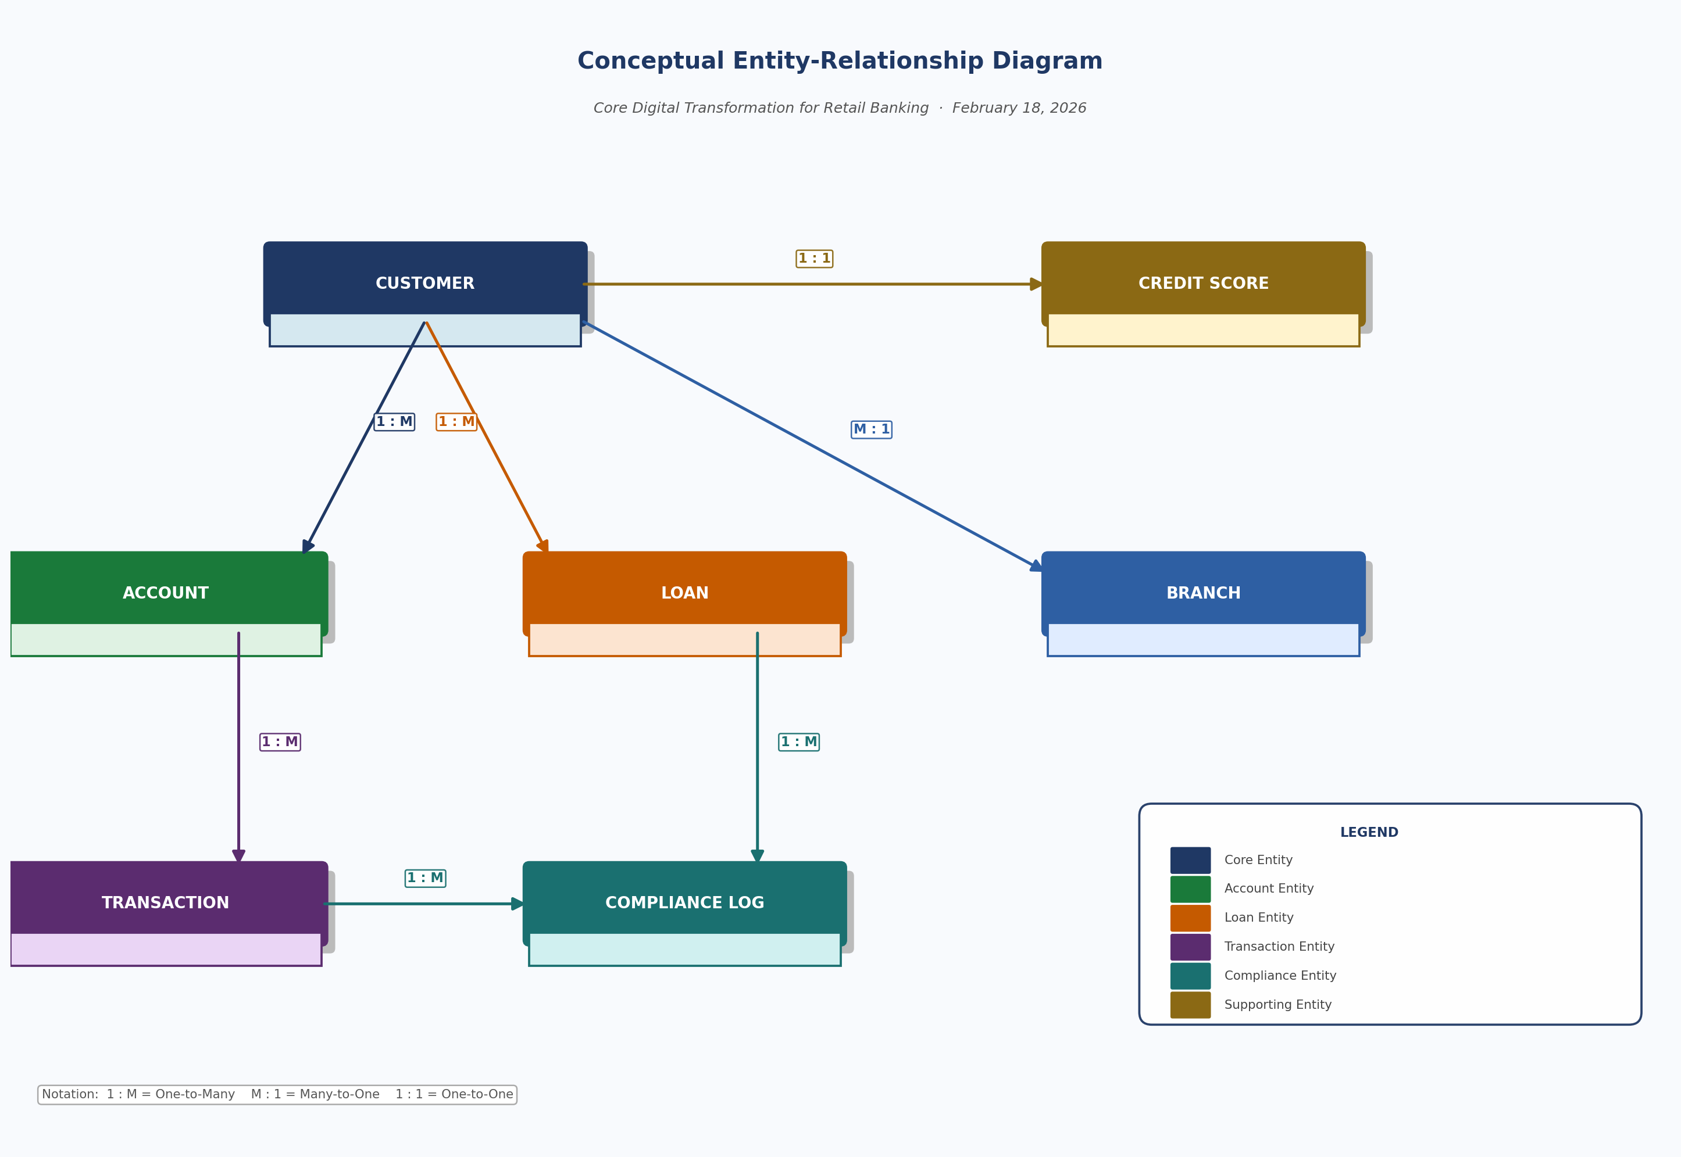
Database design
Conceptual ERD

Slide 25
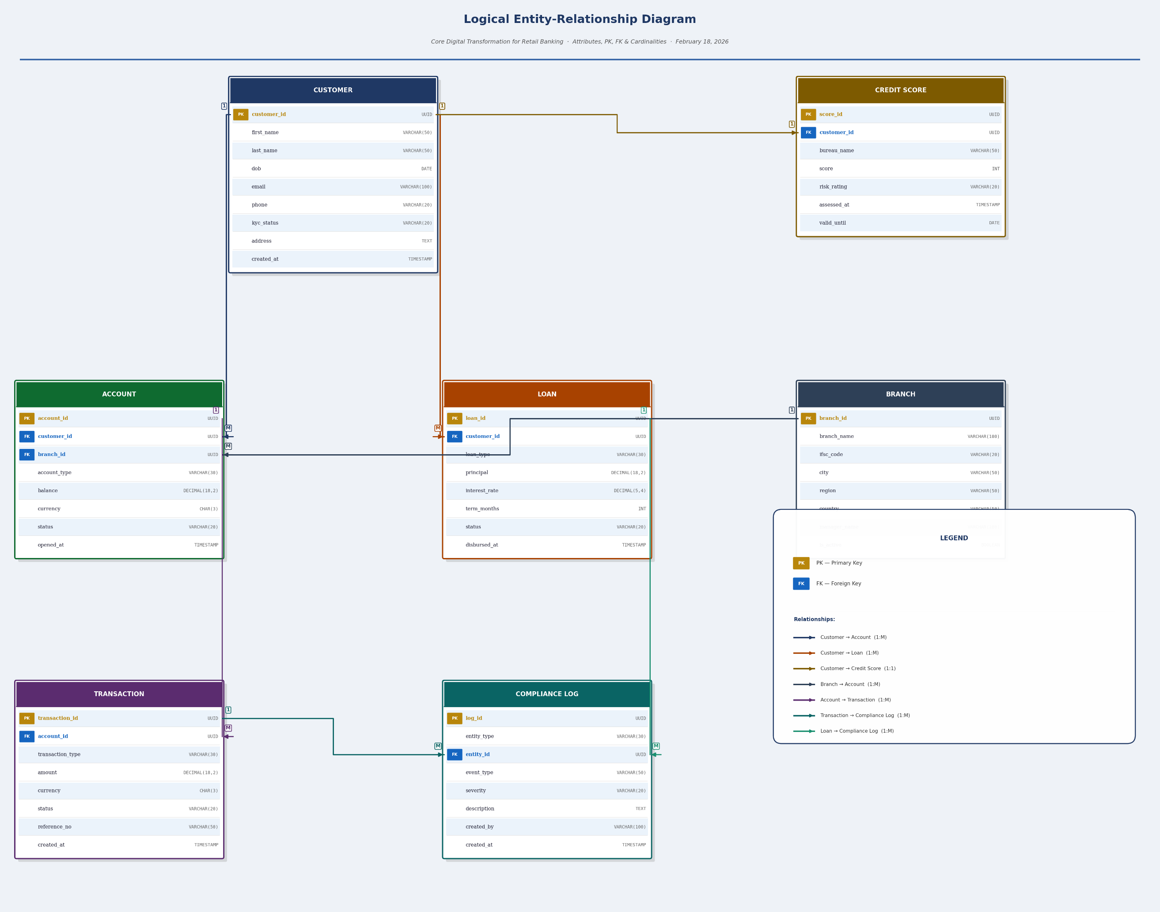
Database design
Logical ERD

Slide 26
Database design
Data Dictionary
Field | Data Type | Description | Constraints
customer_id | UUID | Unique customer identifier (PK) | PRIMARY KEY, NOT NULL
first_name | VARCHAR(50) | Customer's legal first name | NOT NULL
last_name | VARCHAR(50) | Customer's legal last name | NOT NULL
dob | DATE | Date of birth for KYC verification | NOT NULL
email | VARCHAR(100) | Primary contact email address | UNIQUE, NOT NULL
kyc_status | VARCHAR(20) | KYC verification state | CHECK IN ('PENDING','VERIFIED','REJECTED')
created_at | TIMESTAMP | Record creation timestamp | DEFAULT NOW()

Slide 27
Database design
Data Migration Strategy
Migration Flow: Legacy Source Systems → ETL Extract → Staging Area → Data Validation → Transform & Cleanse → Load to EDW → Parallel Validation → Go/No-Go Gate → Production Cutover Rollback available at every arrow. Legacy systems remain live until final cutover is signed off.

Slide 28
Database design
Normalization and Key Table Details
Step | Action Taken | Example
1NF | Ensured all columns contain atomic (indivisible) values. Removed multi-valued fields — e.g., a customer's multiple phone numbers stored in a single column were split into a separate PhoneNumbers table. Ensured each table has a defined primary key. | customer.phone split from a comma-separated list into separate rows with customer_id as FK. Every table assigned a UUID primary key.
2NF | Eliminated partial dependencies. Ensured all non-key attributes depend on the full primary key, not just part of it. Applied to composite-key tables by separating attributes that depend on only one part of the composite key. | In a hypothetical OrderItem table with (order_id, product_id) as PK, product_name depended only on product_id — moved to a Products table. In Transactions, account_type was moved to Accounts.
3NF | Removed transitive dependencies. Ensured non-key attributes depend only on the primary key, not on other non-key attributes. Extracted any derived or indirectly dependent data into separate reference tables. | In Customer, branch_city and branch_region transitively depended on branch_id — extracted to a dedicated Branch table. Credit Score data separated from Customer to its own table since it depends on bureau assessment, not just customer identity.

Slide 29
Test planning and case design using TDD and BDD
Test plan
[Summarize the testing scope, approach, and key activities created in Lab: Reviewing Test Plans and TDD/BDD Test Cases.]

Slide 30
Test planning and case design using TDD and BDD
TDD and BDD test cases
[Provide examples linking requirements to test cases in TDD/BDD format created in Lab: Reviewing Test Plans and TDD/BDD Test Cases.]

Slide 31
CI/CD workflow and monitoring plan
CI workflow
[Include the CI workflow created in Lab: Create a CI/CD Pipeline and Monitoring Strategies.]

Slide 32
CI/CD workflow and monitoring plan
CD pipeline diagram
[Include the CD pipeline diagram created in Lab: Create a CI/CD Pipeline and Monitoring Strategies.]

Slide 33
CI/CD workflow and monitoring plan
Configuration guides for database, API gateway, CI/CD components
[Include the configuration guides for database, API gateway, CI/CD components created in Lab: Create a CI/CD Pipeline and Monitoring Strategies.]

Slide 34
CI/CD workflow and monitoring plan
Backup and disaster recovery plan
[Include the backup and disaster recovery plan created in Lab: Create a CI/CD Pipeline and Monitoring Strategies.]

Slide 35
CI/CD workflow and monitoring plan
Monitoring framework
[Include the monitoring framework created in Lab: Create a CI/CD Pipeline and Monitoring Strategies.]

Slide 36
CI/CD workflow and monitoring plan
Cloud components
[Include the cloud components created in Lab: Create a CI/CD Pipeline and Monitoring Strategies.]

Slide 37
Findings and Recommendations

Slide 38
Key findings
[Reuse the most significant, data-backed findings from your earlier labs. Keep this to the three most important insights, with metrics where possible.]
1.
2.
3.

Slide 39
Key recommendations
[Present the top three to four prioritized recommendations from your prior analysis labs. Include a short note on the expected impact for each.]
1.
2.
3.
4.

Slide 40
Conclusion
[Include a summary of observations in 3–4 bullet points.]
1.
2.
3.
4.

Slide 41
Appendix
1 Develop a project charter
2 Develop a stakeholder register
3 Develop a stakeholder engagement plan (PMI scale)
4 Draft a Business Requirements Document (BRD)
5 Elicit requirements via interviews/workshops
6 Create a use case diagram and detailed flow descriptions
7 Build requirements traceability matrix (RTM)
8 Build a work breakdown structure (WBS) and network diagram
9 Perform SWOT analysis
10 Develop a Risk Register
11 Create Process Models and Visualization
12 Design initial container topology
13 Build Dockerfiles for three microservices
14 Push Docker images to IBM Cloud Container Registry (ICR)
15 Data Flowchart for the Consolidation of Data Infrastructure
16 Design EDA Blueprint
17 Preparing Capacity Planning
18 Creating an Infrastructure Inventory
19 Create System Models, Use Cases, and Sequence Diagrams
20 Technology Stack Recommendations
21 Developing Proof of Concept (PoC) Reports
22 Reviewing Test Plans and Creating TDD/BDD Test Cases
23 Create a CI/CD Pipeline and Monitoring Strategy
24 Designing Backup and Recovery Plans
25 Documenting Configuration for Solution Components
26 Documenting APIs and Data Flows

